Slide 1
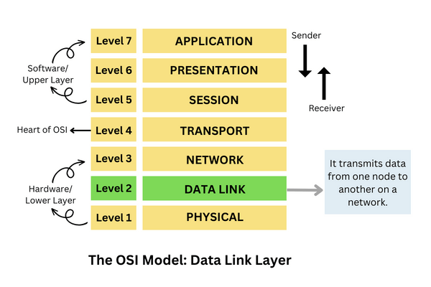
Lec - 19 , 20
Data Link Layer
(Multiple Access Protocols)

Slide 2
What is Data Link Layer ?
The data link layer is Layer 2 in the Open Systems Interconnection (OSI) architecture model for a set of telecommunication protocols.
The data link layer is the protocol layer in a program that handles the moving of data into and out of a physical link in a network.
It is responsible for the node-to - node delivery of data and frame are used in it . Its major role is to ensure error-free transmission of information. DLL is also responsible to encode, decode and organize the outgoing and incoming data.

Slide 3
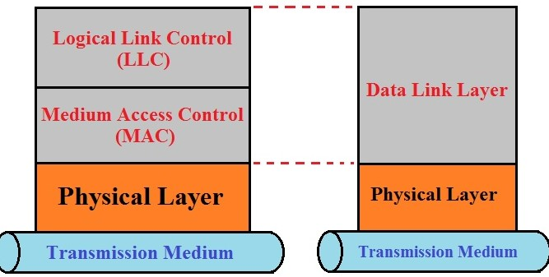
What is MAC sublayer ?
Media Access Control (MAC) sublayer provides control for accessing the transmission medium. It is responsible for moving data packets from one network interface card (NIC) to another, across a shared transmission medium. Physical addressing is handled at the MAC sublayer. MAC is also handled at this layer.

Slide 4
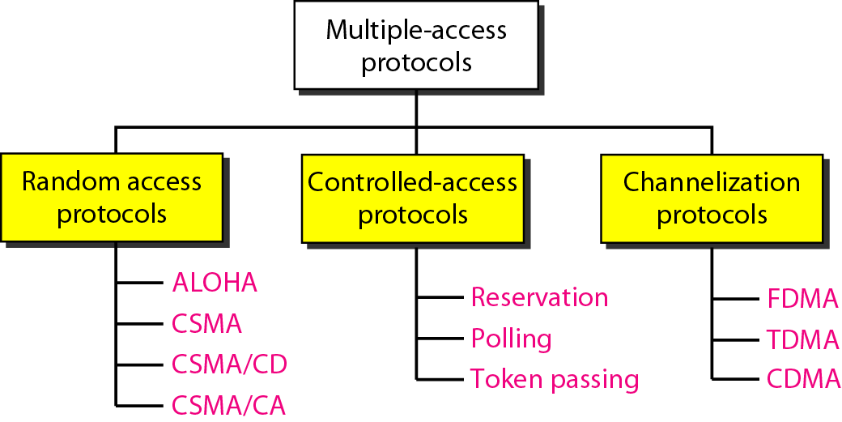
Why we use multiple access protocols ?
When a number of stations (users ) use a common link of communication system we have to use a multiple access protocols .

Slide 5
Types of Multiple -access protocols.

Slide 6
What is Random Access Protocols?
In the random access there is no control station.
Each station will have the right to use the common medium without any control over it.
Random access protocols are communication protocols that allow multiple devices to access a shared communication channel or medium in random or arbitrary order. Devices access the medium by using a method called random access.

Slide 7
What are the examples of random access protocols ?
In random access or contention methods, no station is superior to another station and none is assigned the control over another. No station permits, or does not permit, another station to send. At each instance, a station that has data to send uses a procedure defined by the protocol to make a decision on whether or not to send.
Examples of random access protocols.
ALOHA
Carrier Sense Multiple Access
Carrier Sense Multiple Access with Collision Detection
Carrier Sense Multiple Access with Collision Avoidance

Slide 8
Multiple access ( ALOHA System ) .
ALOHA is an early random access protocol used in computer networks. It was first used in the ALOHA net network at the University of Hawaii in the 1970s. The basic operation of the ALOHA protocol is as follows:
Devices can transmit data whenever they have a message to send .
If two or more devices transmit simultaneously, their messages will collide and be corrupted.
Devices that detect a collision will wait for a random amount of time before trying to transmit again.
ALOHA has two variants:-
Pure ALOHA -In this version, devices can transmit at any time. There is no coordination between devices .
Slotted ALOHA -The slotted ALOHA divides time into slots and only allows devices to transmit at the beginning of a slot, which reduces the probability of collision .

Slide 9
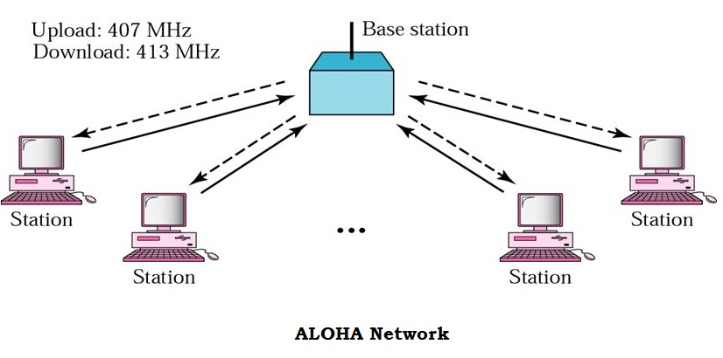

Slide 10
What is Pure ALOHA ?
Pure ALOHA is a simple and early random access protocol.
In this protocol, any device can transmit data anytime without checking whether the channel is in use. This can lead to collisions, where two or more devices transmit simultaneously, resulting in data corruption and lost packets.
Pure ALOHA employs a “send and hope” mechanism to recover from these collisions. Devices send their data and hope it reaches its destination without colliding with other transmissions. If a collision occurs, the devices involved wait for a random amount before resending the data.

Slide 11
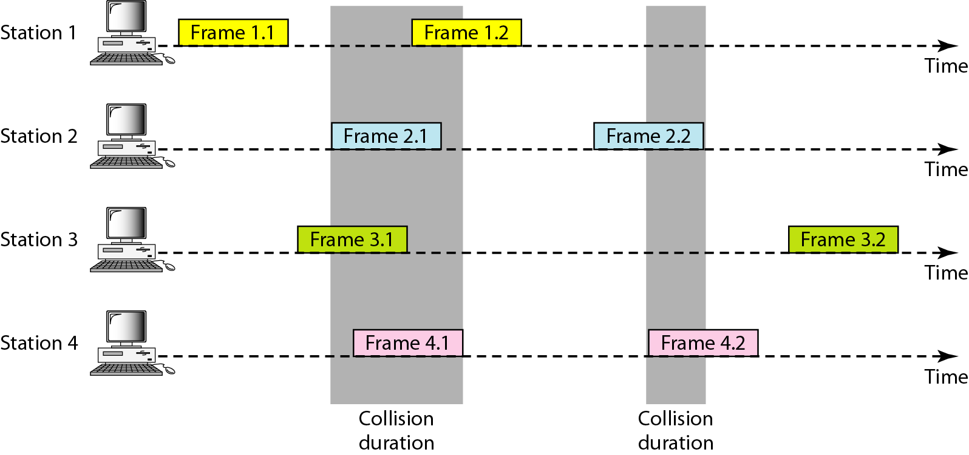
Diagram of Pure ALOHA .

Slide 12
Disadvantages of Pure Aloha .
Pure ALOHA is a simple protocol allowing multiple nodes to share a single communication channel. However, it is inefficient due to the high probability of collisions. Thus, it laid the foundation for developing more sophisticated random access protocols, such as Slotted ALOHA and CSMA/CD.

Slide 13
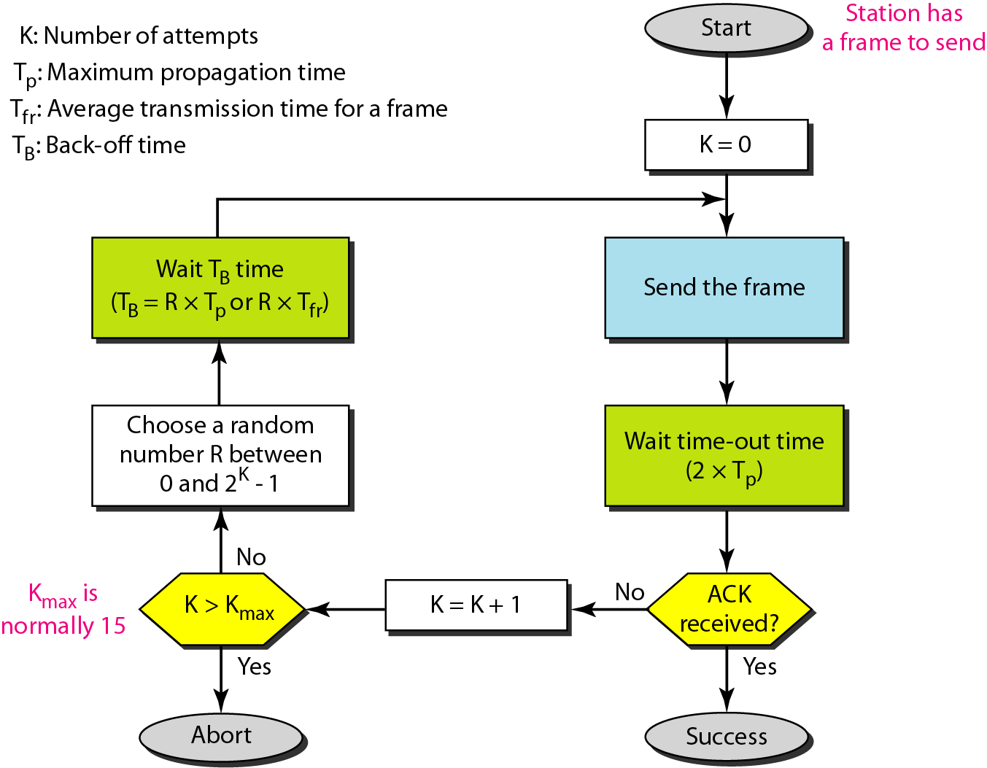
Procedure for pure ALOHA protocol.

Slide 14
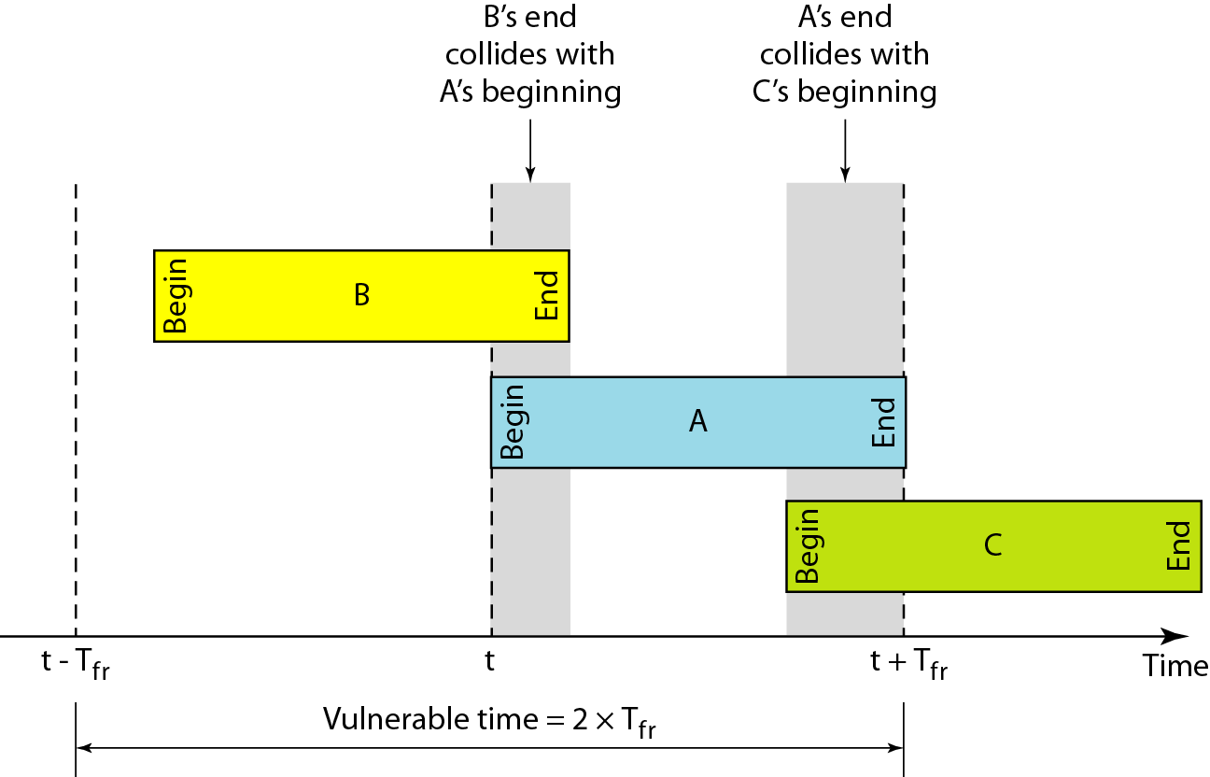
Vulnerable time for pure ALOHA protocol.

Slide 15

Note
The throughput for pure ALOHA is S = G × e ^{−2G} .
The maximum throughput
S_{max} = 0.184 when G= (1/2).

Slide 16
Slotted ALOHA .
Slotted ALOHA is an advance version of the pure ALOHA protocol.
The main aim to design the slotted Aloha is to make communication networks more efficient.
In this version, the channel is divided into small, fixed-length time slots and users are only allowed to transmit data at the beginning of each time slot.
This synchronization of transmissions reduces the chances of collisions between devices, increasing the overall efficiency of the network.
In the slotted Aloha all the users are synchronized to these time slots so that whenever a user sends a packet, it must precisely match the next available channel slot. As a result, wasted time due to collisions can be reduced to one packet time or the susceptible period can be half.

Slide 17
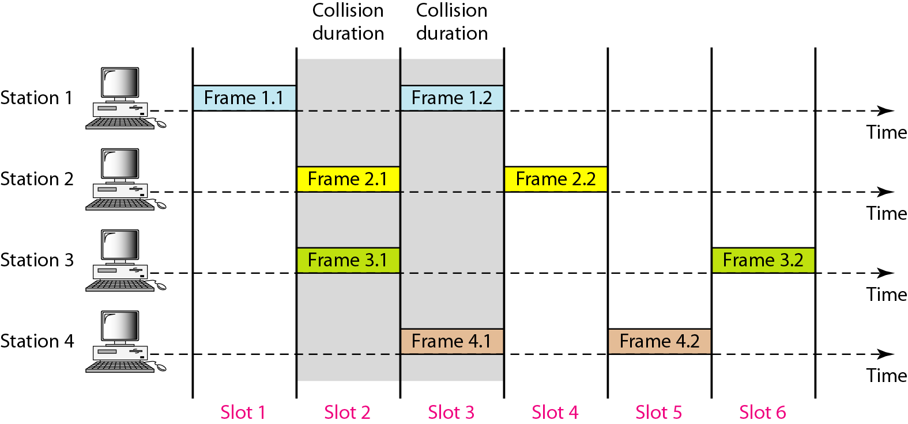
Diagram of Slotted Aloha.

Slide 18
Note
The throughput for slotted ALOHA is S = G × e^{−G} .
The maximum throughput S_{max} = 0.368 when G = 1.

Slide 19
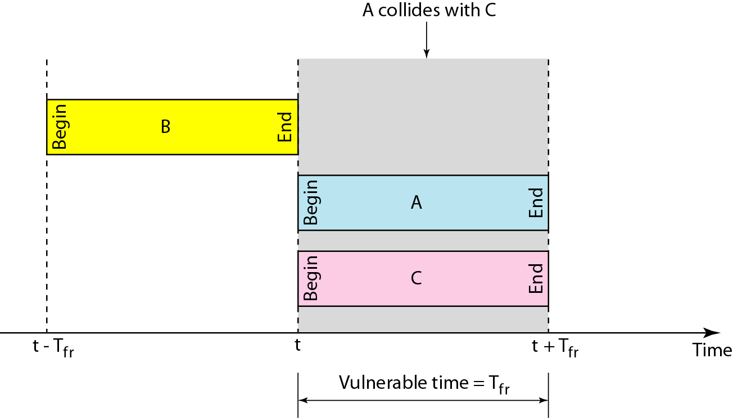
Vulnerable time for slotted ALOHA protocol .

Slide 20
Difference between Pure and slotted Aloha.
Pure Aloha.
Any station can transmitted data at any time .
Time is continuous .
Slotted Aloha.
Any station can transmitted the data at the beginning of any time slot .
Time is divided into fixed time slot.

Slide 21
CSMA (Carrier sense Multiple Access )
CSMA operates on the principle of carrier sensing .
In this protocol , a station listens to see the presence of transmission (carrier ) on the cable and decides to act accordingly .
Carrier sense multiple access is based on media access protocol to sense the traffic on a channel (idle or busy) before transmitting the data. It means that if the channel is idle, the station can send data to the channel. Otherwise, it must wait until the channel becomes idle. Hence, it reduces the chances of a collision on a transmission medium.

Slide 22
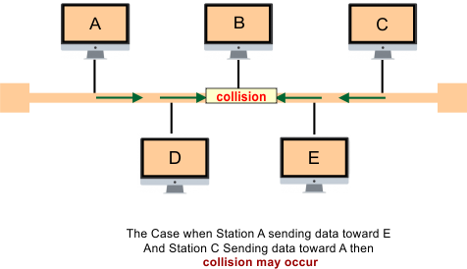
How the collision may occur ?

Slide 23
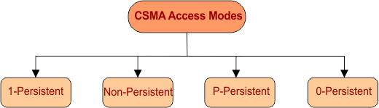
There are four major modes of CSMA .

Slide 24
Types of CSMA .
1. Non -Persistent CSMA -
In this scheme , if a station wants to transmit a frame and it finds that the channel is busy (some other station is transmitting ) then it will want for fixed interval of time .
After this time , it again checks the status of the channel and if the channel is free the it will transmit.
1- Persistent CSMA -
In this scheme the station which wants to transmit , continuously monitors the channel until is idle and then transmits immediately .
After sensing the medium in 1-persistent, if the channel is idle then station starts transmission immediately. Otherwise, it senses the transmission medium continuously until it becomes idle.
Wait for transmission is minimum because of continuously sensing the medium. So, probability of frame transmissions is always 1.
After collision, CSMA use Acknowledgement signal for retransmission of collided frame.

Slide 25
P-Persistent –
In this scheme , all the waiting channels are not allowed to transmit simultaneously as soon as the channel becomes idles.
P-persistent is applied in slotted channels. It is the combination of 1-Persistent and Non-persistent modes. Its transmission probability (p) is in-between 1 and 0.
In P-persistent transmission only occur when it satisfy the following conditions.
Medium is idle.
And beginning of slot is also available for sensing station.

Slide 26
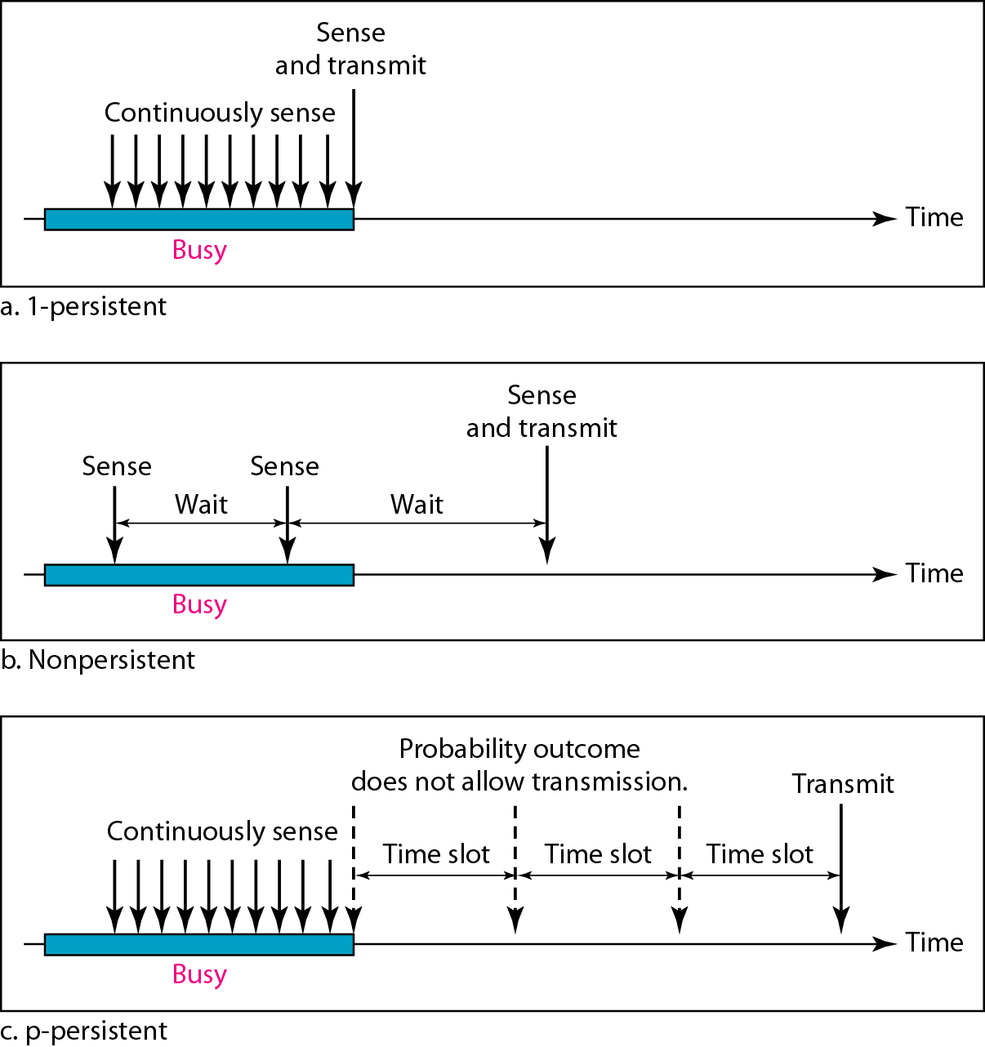
Types of CSMA.

Slide 27
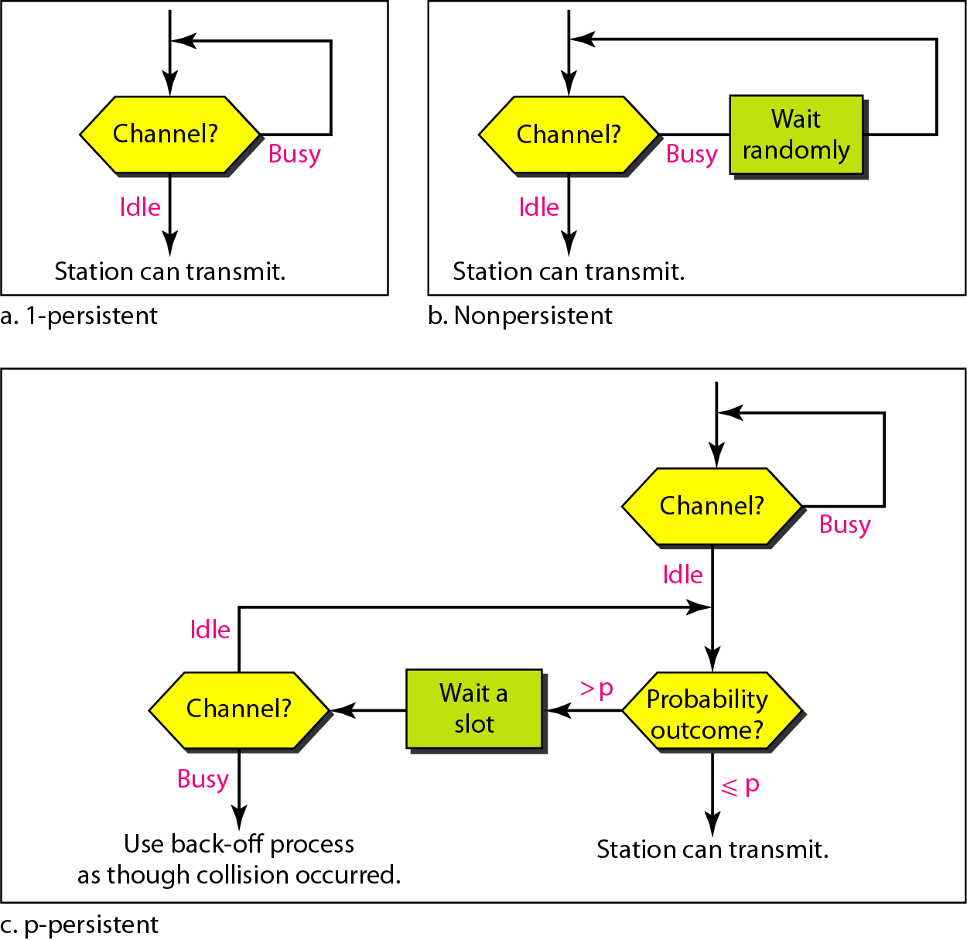
Flow diagram for three persistence methods.

Slide 28
What is CSMA/CD?
CSMA/CD stands for Carrier Sense Multiple Access/Collision Detection, with collision detection being an advance extension of the CSMA protocol.
This creates a procedure that regulates how communication must take place in a network with a shared transmission medium.
Carrier Sense Multiple Access with Collision Detection (CSMA/CD) is a network protocol for carrier transmission that operates in the Medium Access Control (MAC) layer. It senses or listens whether the shared channel for transmission is busy or not, and defers transmissions until the channel is free. The collision detection technology detects collisions by sensing transmissions from other stations. On detection of a collision, the station stops transmitting, sends a jam signal, and then waits for a random time interval before retransmission.

Slide 29
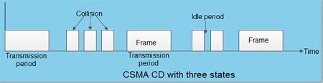
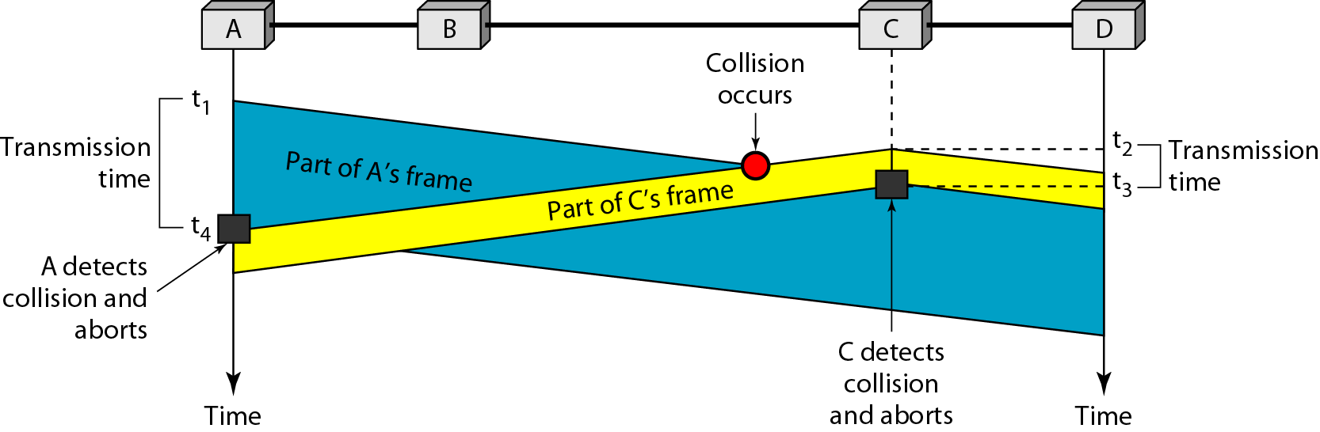
Collision and abortion in CSMA/CD.

Slide 30
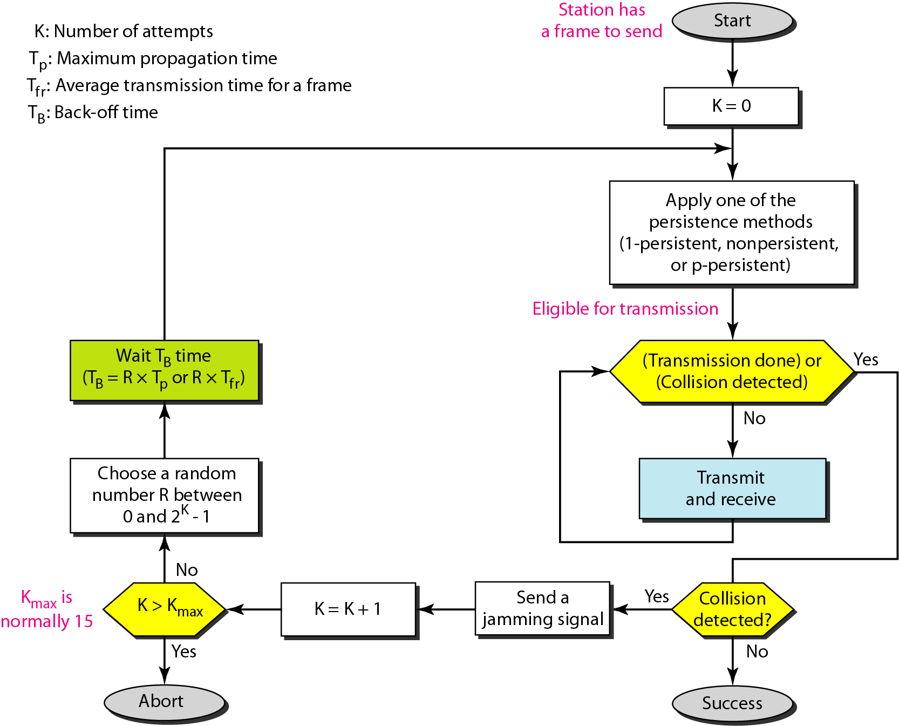
Flow diagram for the CSMA/CD .

Slide 31
CSMA /CA
Carrier Sense Multiple Access with Collision Avoidance (CSMA/CA) is a network protocol for carrier transmission that operates in the Medium Access Control (MAC) layer.
In contrast to CSMA/CD (Carrier Sense Multiple Access/Collision Detection) that deals with collisions after their occurrence, CSMA/CA prevents collisions prior to their occurrence.

Slide 32
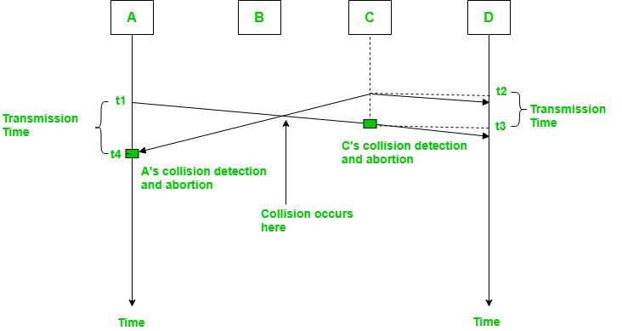
Diagram of CSMA / CD.

Slide 33
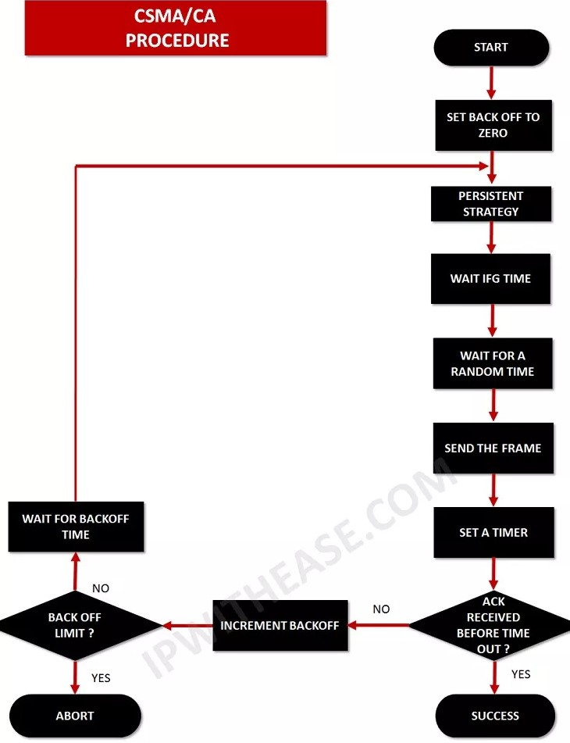

Slide 34
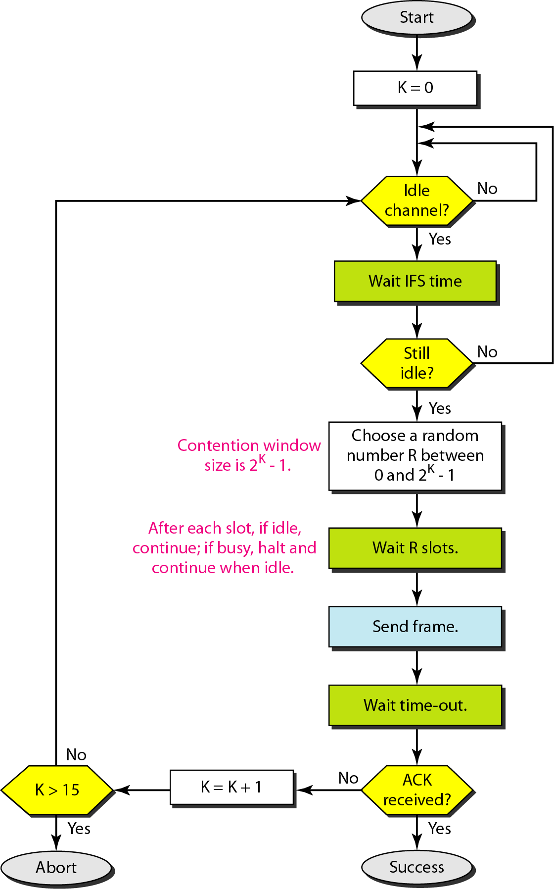
Flow diagram of CSMA/CD.

Slide 35
12-2 CONTROLLED ACCESS
In controlled access, the stations consult one another to find which station has the right to send. A station cannot send unless it has been authorized by other stations. We discuss three popular controlled-access methods.

Slide 36
Reservation
In the reservation method, a station needs to make a reservation before sending data. Time is divided into intervals. In each interval, a reservation frame precedes the data frames sent in that interval.
If there are N stations in the system, there are exactly N reservation minislots in the reservation frame. Each mini slot belongs to a station. When a station needs to send a data frame, it makes a reservation in its own mini slot. The stations that have made reservations can send their data frames after the reservation frame.
The following figure shows a situation with five stations and a five-mini slot reservation frame. In the first interval, only stations 1, 3, and 4 have made reservations. In the second interval, only station 1 has made a reservation.

Slide 37
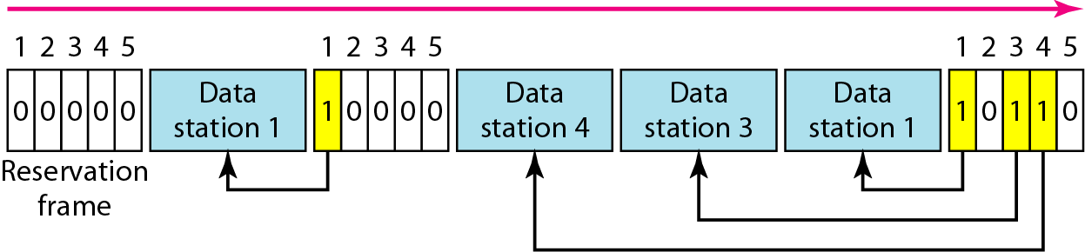
Diagram of Reservation Protocol.

Slide 38
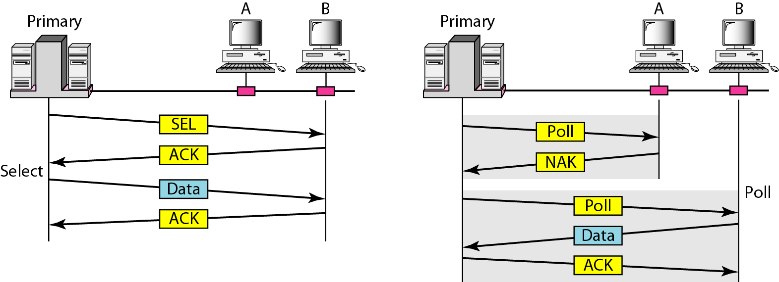
Polling protocol .
Polling works with topologies in which one device is designated as a primary station and the other devices are secondary stations. All data exchanges must be made through the primary device even when the ultimate destination is a secondary device.
The primary device controls the link; the secondary devices follow its instructions. It is up to the primary device to determine which device is allowed to use the channel at a given time. The primary device, therefore, is always the initiator of a session. Consider the following figure.

Slide 39
Token Passing Protocol.
In the token-passing method, the stations in a network are organized in a logical ring. In other words, for each station, there is a predecessor and a successor. The predecessor is the station which is logically before the station in the ring; the successor is the station which is after the station in the ring. The current station is the one that is accessing the channel now. The right to this access has been passed from the predecessor to the current station. The right will be passed to the successor when the current station has no more data to send.
In this method, a special packet called a token circulates through the ring. The possession of the token gives the station the right to access the channel and send its data. When a station has some data to send, it waits until it receives the token from its predecessor. It then holds the token and sends its data. When the station has no more data to send, it releases the token, passing it to the next logical station in the ring. The station cannot send data until it receives the token again in the next round.
Token management is needed for this access method. Stations must be limited in the time they can have possession of the token. The token must be monitored to ensure it has not been lost or destroyed. For example, if a station that is holding the token fails, the token will disappear from the network. Another function of token management is to assign priorities to the stations and to the types of data being transmitted. And finally, token management is needed to make low- priority stations release the token to high priority stations.

Slide 40
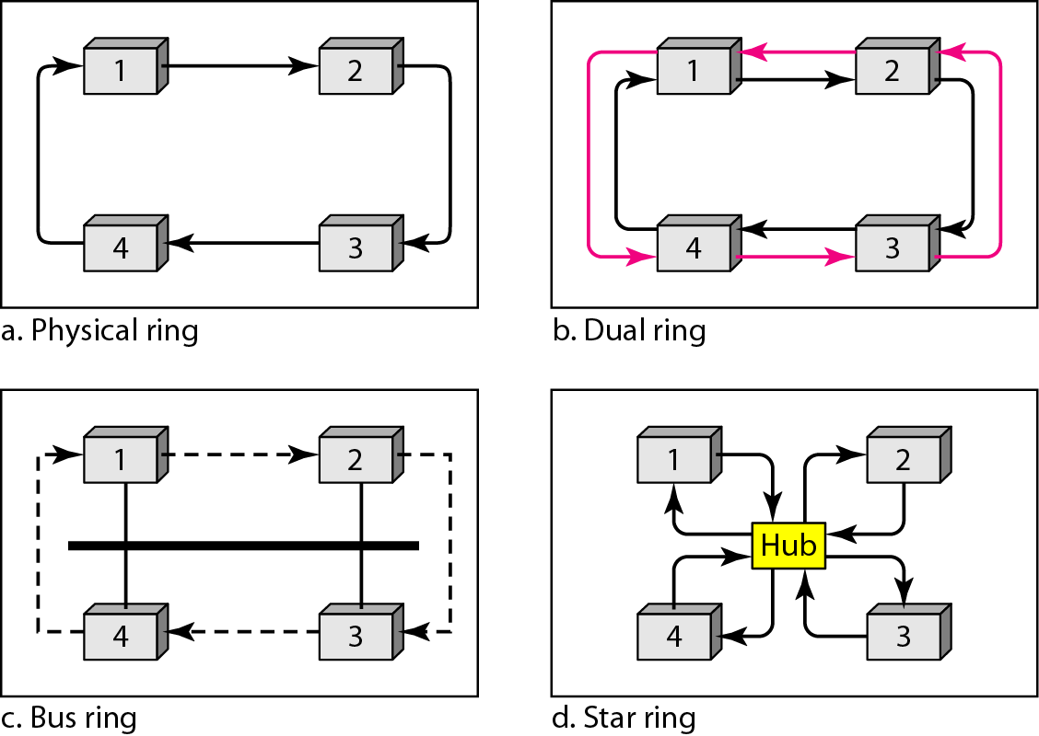
Logical ring and physical topology in token-passing access method.

Slide 41
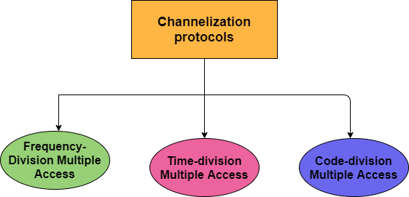
What is channelization protocols ?
Channelization is basically a method that provides the multiple-access and in this, the available bandwidth of the link is shared in time, frequency, or through the code in between the different stations.

Slide 42
FDM (Frequency Division Multiplexing )
It is a type of technique which is based on sharing bandwidth of a common communication channel.
The main aim of the FDM is to subdivide the available bandwidth into different frequency channels and allocate them to different devices.
It is an analog technique. It is mainly used in radio broadcasts and TV networks.

Slide 43
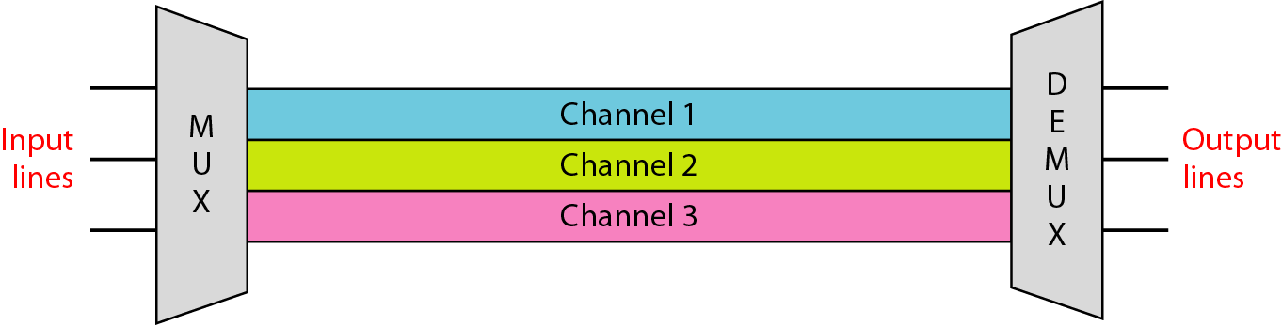
Diagram of FDM.

Slide 44
What are Advantages Of FDM ?
FDM is used for analog signals.
FDM process is very simple and easy modulation.
A Large number of signals can be sent through an FDM simultaneously.
It does not require any synchronization between sender and receiver.

Slide 45
Disadvantages of FDM.
FDM technique is used only when low-speed channels are required.
It suffers the problem of crosstalk.
A Large number of modulators are required.
It requires a high bandwidth channel.

Slide 46
What is Time division Multiplexing ?
Time-division multiplexing is defined as a type of multiplexing wherein FDM, instead of sharing a portion of the bandwidth in the form of channels, in TDM, time is shared. Each connection occupies a portion of time in the link.
In Time Division Multiplexing, all signals operate with the same frequency (bandwidth) at different times.

Slide 47
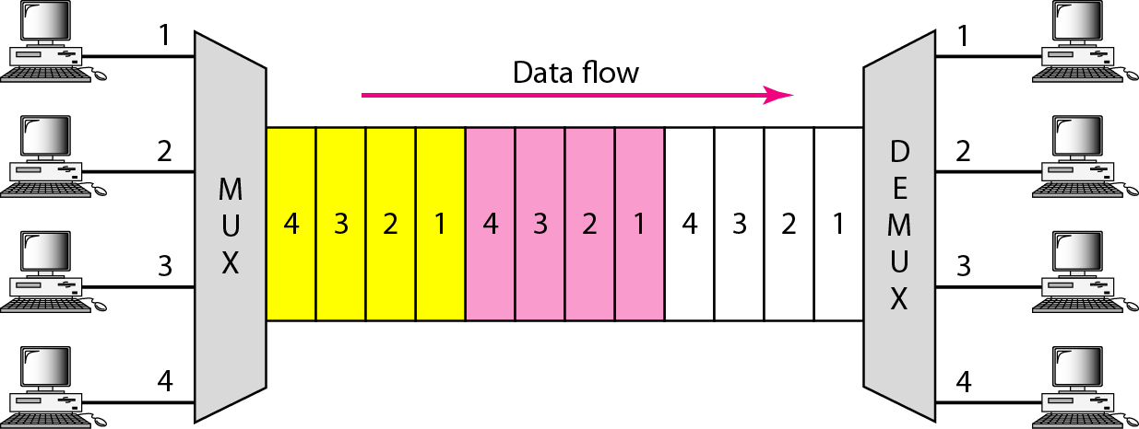
Time Division Multiplexing .

Slide 48
There are two types of Time Division Multiplexing.
Synchronous Time Division Multiplexing .
Statistical (or Asynchronous) Time Division Multiplexing .
Synchronous TDM : Synchronous TDM is a type of Time Division Multiplexing where the input frame already has a slot in the output frame. Time slots are grouped into frames. One frame consists of one cycle of time slots.

Slide 49
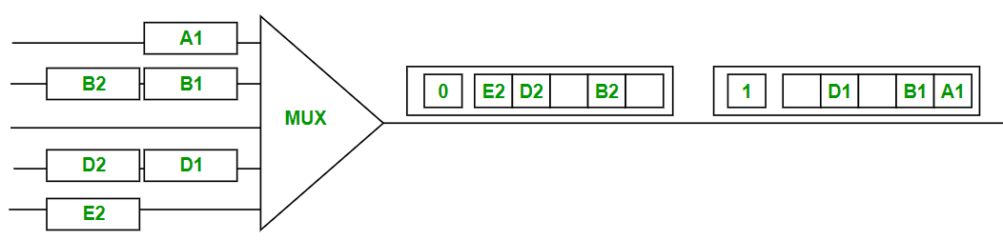
Synchronous Time Division Multiplexing .

Slide 50
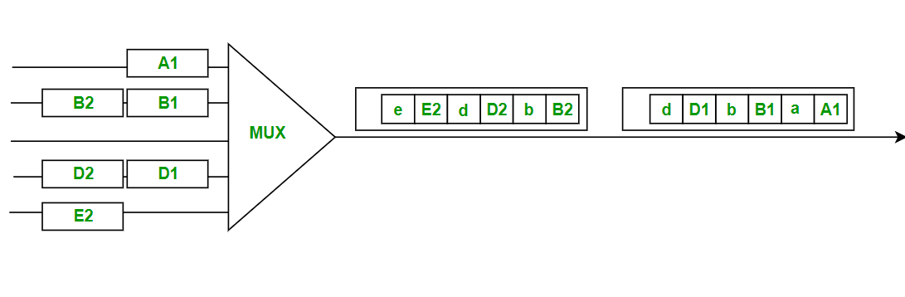
Statistical TDM .
Statistical TDM is a type of Time Division Multiplexing where the output frame collects data from the input frame till it is full, not leaving an empty slot like in Synchronous TDM.
In statistical TDM, we need to include the address of each particular data in the slot that is being sent to the output frame.

Slide 51
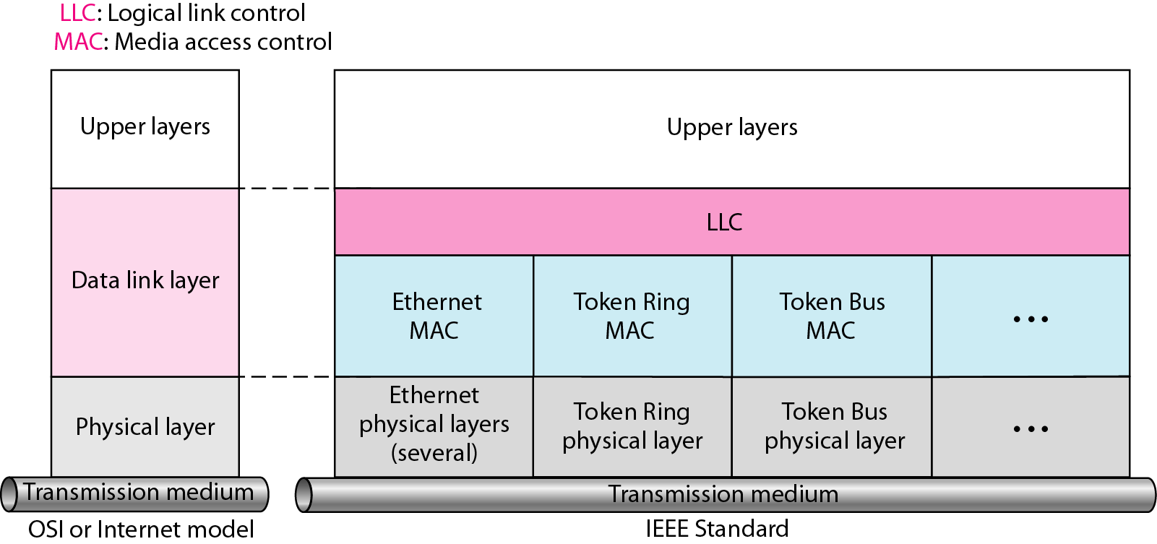
Ethernet protocol .
In the OSI network model, Ethernet protocol operates at the first two layers like the Physical & the Data Link layers but, Ethernet separates the Data Link layer into two different layers called the Logical Link Control layer & the Medium Access Control layer.

Slide 52
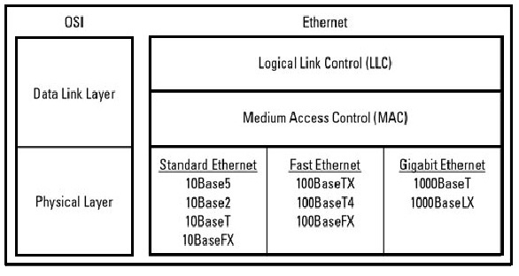
Ethernet protocols Architecture.
The physical layer in the network mainly focuses on the elements of hardware like repeaters, cables & network interface cards (NIC). For instance, an Ethernet network like 100BaseTX or 10BaseT indicates the cables type that can be used, the length of cables, and the optimal topology.

Slide 53
How Ethernet Protocol Works?
Ethernet protocol mainly works in the first two layers in the OSI network model like data-link & physical. Ethernet at the first layer uses signals, bitstreams that move on the media, physical components that situate signals on media & different topologies.
The sub-layers of Data Link give significantly to technological compatibility & computer communications. The MAC sublayer is anxious through the physical components that will be utilized to converse the information & arrange the data for communication over the media. The Logical Link Control sublayer will stay independent of the physical equipment that will be utilized for the process of communication.

Slide 54
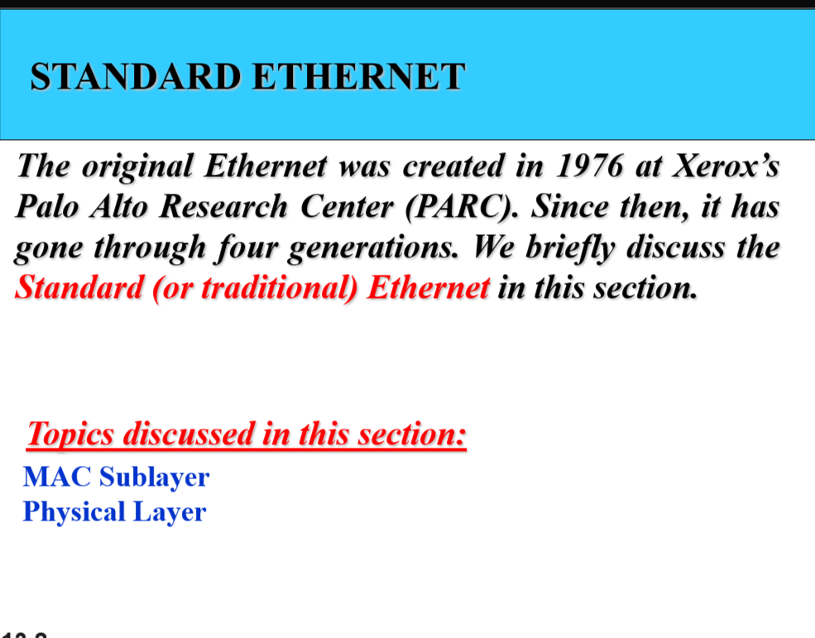

Slide 55
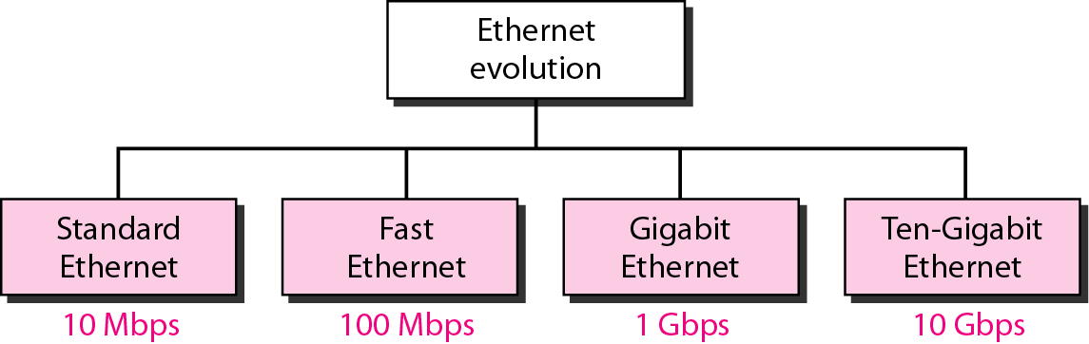
Ethernet evolution through four generations.

Slide 56
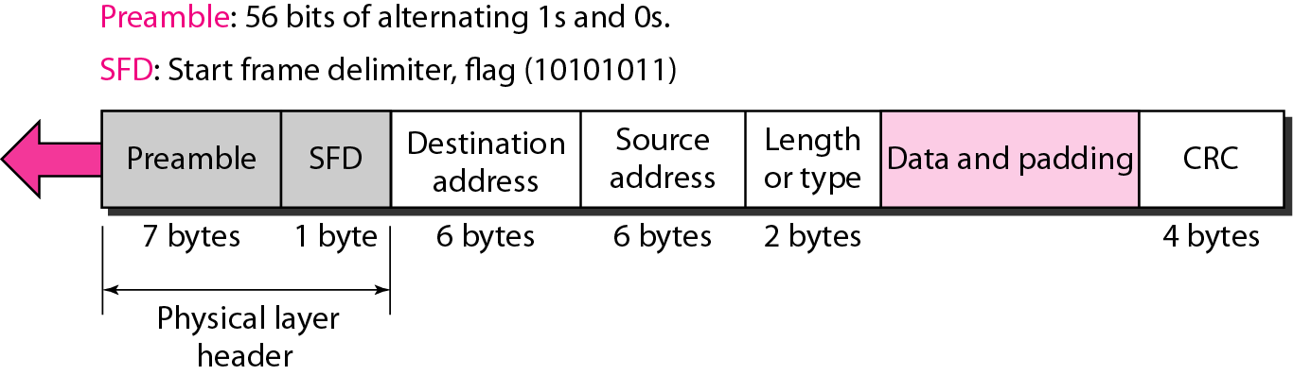
802.3 MAC frame

Slide 57
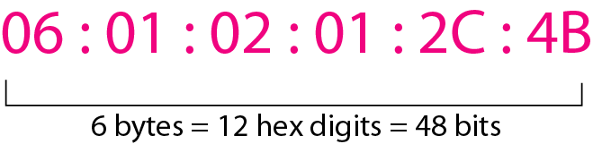
Example of an Ethernet address in hexadecimal notation. .

Slide 58
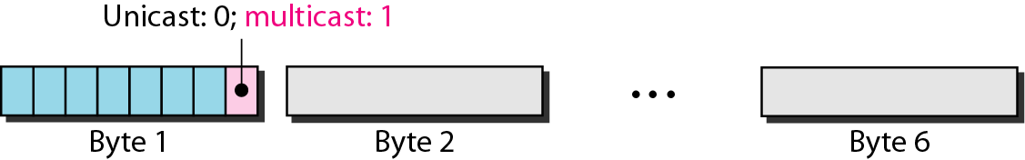
Unicast and multicast addresses.

Slide 59
Advantages of Ethernet protocol.
Security, speed, efficiency, and reliability.
The Gigabit Ethernet provides very fast speed like 1Gbps. Its speed mainly ranges from above 10 times as compared to Fast Ethernet.
Less cost.
It does not need any hubs or switches
Simple maintenance
It is very strong toward the noise.
The data transfer doesn’t degrade.
The quality of data transfer is good.

Slide 60
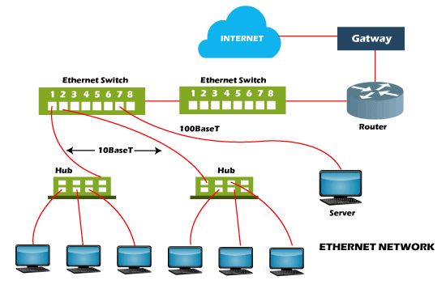
Ethernet Networks .

Slide 61
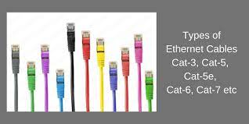
Types of ethernet cables.

Slide 62


